Slide 1
The File System

Slide 2
Learning Objectives
Explain Linux filesystem
Display and interpret directory ownership
Change file and directory permissions
Describe differences between hard and symbolic links.
Describe inode, and its relationship with files and directories

Slide 3
What is a File System?
An abstraction of data storage on a system
Used to control how information is stored and retrieved (Wikipedia)
Can be used on many different kind of media: hard drive, magnetic tape, optical disc, and flash memory
Notes:
In computing, a file system (or filesystem) is used to control how information is stored and retrieved. Without a file system, information placed in a storage area would be one large body of information with no way to tell where one piece of information stops and the next begins. By separating the information into individual pieces, and giving each piece a name, the information is easily separated and identified.

Slide 4
In Linux, Everything is a File!
Files
Regular
Directories
Special
Links
FIFO Files
Sockets
Notes:
A simple description of the UNIX system, also applicable to Linux, is this: "On a UNIX system, everything is a file.“ A Linux system, just like UNIX, makes no difference between a file and a directory, since a directory is just a file containing names of other files. Programs, services, texts, images, and so forth, are all files. Input and output devices, and generally all devices, are considered to be files, according to the system.
For Linux, devices can be termed as special files that represent physical or virtual devices attached to Linux system. These special files are used by the Linux operating system to enable access to the physical or virtual devices. This was done in order to make these device accessible using standard I/O operations. Every such device would need to have its specific device driver, which is a Linux kernel module, leveraging the users and the user space programs to interact with the devices. In Linux, every device needs to have device driver so that it can be made accessible by the OS to the users. The device driver actually provides the standard input/output calls to access the device and interact with it. Worth mentioning, all the device drivers are kernel modules in Linux.
All the devices on the Linux can be viewed through:
cat /proc/devices
All the devices will be listed.
We see quite a lot familiar devices here, like, memory, ramdisk, usb, etc. However, apart from the external physical devices, Linux also recognizes virtual devices which can be created given a memory range, and accessed using its device drivers through the I/O methods. For example, note the device tty, which is the terminal. Physically, a Linux terminal is not a device, but it is treated as a device, and hence listed out here. Hence, Linux device drivers provide the capability to create and use virtual devices also on Linux.
One can also find all the device nodes created at:
ls /dev/
• Regular Files: Regular files contain user data that need to be available for future processing. Sometimes called ordinary files, regular files are the most common files found in a system. Throughout the rest of the text, whenever we use “file” without any qualification (that is, by itself), we are referring to a regular file.
• Directory Files: A directory is a file that contains the names and locations of all files stored on a physical device. Throughout the rest of the text, whenever we use “directory” without any qualification (that is, by itself), we are referring to a directory file.
• Character Special Files: A character special file represents a physical device, such as a terminal, that reads or writes one character at a time. E.g., tty
• Block Special Files: A block special file represents a physical device, such as a disk, that reads or writes data a block at a time.
• Symbolic Link Files: A symbolic link is a logical file that defines the location of another file somewhere else in the system.
• FIFO Files (Named Pipe): A first-in, first-out file, also known as a named pipe, is a file that is used for interprocess communication. We do not discuss FIFO files in this text.
• Socket: A socket is a special file that is used for network communication

Slide 5
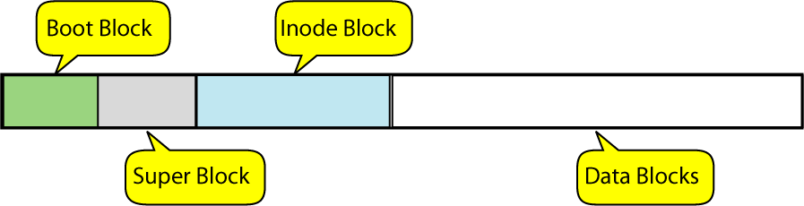
Disk File Format
Notes:
When a disk is formatted, space is divided into several sections. Some sections contain structural information about the disk itself. The last section contains the physical files. In this section, we examine the UNIX file system to better understand how these sections are related.
Disk storage can be conceived of as a continuous linear storage structure, starting with track 0 on the first track surface and moving down through track 0 of all surfaces before continuing with track 1 on the first surface.
In UNIX, a file system has four structural sections known as blocks: the boot block, the super block, the inode block, and the data block. The boot block, super block, and inode blocks are fixed at the beginning of the disk. They occupy the same locations on the disk even when the disk is reorganized. These blocks are shown in the above diagram
Boot Block
When an operating system is started, a small program known as the boot program is used to load the kernel into memory. The boot program, when present, is found at the beginning of a disk in the boot block.
Super Block
The next block on the disk, the super block, contains information about the file system. Stored here are such items as the total size of the disk, how many blocks are empty, and the location of bad blocks on the disk.
Inode Block
Following the super block is the inode (information node) block, which contains information about each file in the data block. The file information is stored in records known as inodes. There is one inode for each file on the disk. They contain information about the file, most notably the owner of the file, its file type, permissions, and address. As shown in the above diagram, each inode contains the address of its corresponding file. (to find an inode, use either ls or stat command – ls –li or stat filename
Data Blocks
The data block contains several types of files. First and foremost from the user’s point of view, it contains all of the user files; it is where data are stored. It also contains the special files that are related to user data: regular files, directory files, symbolic link files, and FIFO files. Finally, it contains the character special, block special, and socket system files.

Slide 6
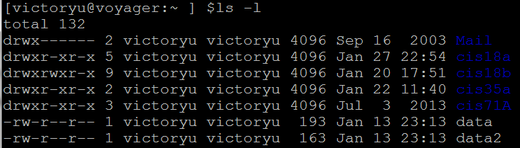
Types of Files
Directories
Regular Files
Symbol | Meaning
- | Regular file
d | Directory
l | Link
c | Special file
s | Socket
p | Named pipe
b | Block device
File types in a long list
Notes:
Regular files (-)
Text files – contain ASCII characters
Binary files – data stored in the internal format of the computer. 2 types: data files and program files
Directories (d) - Perform the same function as a folder in a filing cabinet. It organizes related files and subdirectories in one place.
Special directories
Root directory
Home directory (abreviation ~) – we use the home directory when we first log into
Working directory (.) – the one that we are in at any point in time during a session. When we start, the working directory is our home directory.
Parent directory (..) – immediately above working directory

Slide 7
file : Determine File Type
-b brief
-z uncompress – try to look inside a compressed file
Notes:
The most common file in UNIX is the regular file. Regular files are divided by the physical format used to store the data as text or binary. The physical format is controlled by the application program or utility that processes it. UNIX views both formats as a collection of bytes and leaves the interpretation of the file format to the program that processes it.
Text Files
A text file is a file of characters drawn from the computer’s character set. UNIX computers use the ASCII character set. Because the UNIX shells treat data almost universally as strings of characters, the text file is the most common UNIX file. The ASCII character set is found in Appendix A.
Binary Files
A binary file is a collection of data stored in the internal format of the computer. In general, there are two types of binary files: data files and program files. Data files contain application data. Program files contain instructions that make a program work. If you try to process a binary file with a text-processing utility, the output will look very strange because it is not in a format that can be read by people.

Slide 8
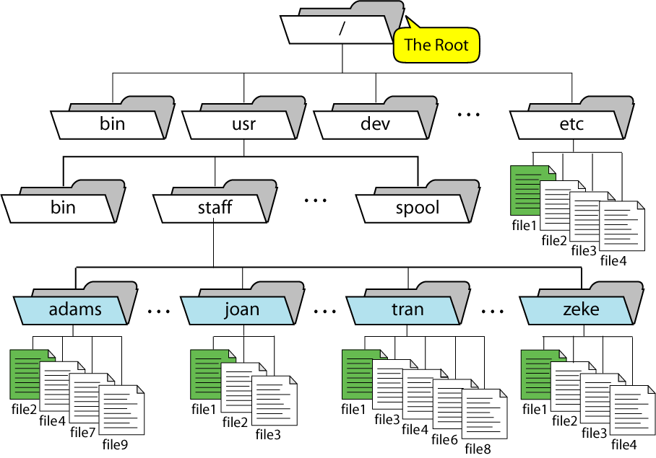
Hierarchical Directory Structure
Notes:
In order to manage all those files in an orderly fashion, man likes to think of them in an ordered tree-like structure on the hard disk, as we know from MS-DOS (Disk Operating System) for instance. The large branches contain more branches, and the branches at the end contain the tree's leaves or normal files. For now we will use this image of the tree, but we will find out later why this is not a fully accurate image.
The tree of the file system starts at the trunk or slash, indicated by a forward slash (/). This directory, containing all underlying directories and files, is also called the root directory or "the root" of the file system.
Directories that are only one level below the root directory are often preceded by a slash, to indicate their position and prevent confusion with other directories that could have the same name. When starting with a new system, it is always a good idea to take a look in the root directory. Let's see what you could run into:
emmy:~> cd / emmy:/> ls bin/ dev/ home/ lib/ misc/ opt/ root/ tmp/ var/ boot/ etc/ initrd/ lost+found/ mnt/ proc/ sbin/ usr/

Slide 9
Directory | Purpose
/ | The root directory; all files appear in this directory or subdirectories of it.
/etc | Holds system configuration files.
/boot | Holds important boot files, such as the Linux kernel, the initial RAM disk, and often boot loader configuration files.
/bin | Holds program files that are critical for normal operation and that ordinary users may run.
/sbin | Holds program files that are critical for normal operation and that ordinary users seldom run.
/lib | Holds libraries—code used by many other programs—that are critical for basic system operation.
/usr | Holds programs and data used in normal system operation but that aren't critical for a bare-bones boot of the system. This directory is split into subdirectories that mirror parts of the root organization—/usr/bin, /usr/sbin, /usr/lib, and so on.
/home | Holds users' home directories. Separating this directory into its own low-level filesystem effectively isolates most user data from the OS, which can be useful if you want to re-install the OS without losing user data.
/root | The root user's home directory. Note that this is different from /, which is pronounced root.
/var | Holds miscellaneous transient files, such as log files and print spool files. One subdirectory of /var, /var/tmp, deserves special mention. Like /tmp(described next), /var/tmpholds temporary files. These files should not be deleted when the computer reboots.
/tmp | Holds temporary files, often including temporary files created by user programs. Such files may theoretically be deleted when the computer reboots, although in practice many distributions don't do this.
/mnt | The traditional mount point for removable media; sometimes split into subdirectories for each mounted filesystem.
/media | The new mount point for removable media; typically split into subdirectories for each mounted filesystem.
/dev | Holds device files, which provide low-level access to hardware.
Notes:
1. / – Root
Every single file and directory starts from the root directory.
Only root user has write privilege under this directory.
Please note that /root is root user’s home directory, which is not same as /.
2. /bin – User Binaries
Contains binary executables.
Common linux commands you need to use in single-user modes are located under this directory.
Commands used by all the users of the system are located here.
For example: ps, ls, ping, grep, cp.
3. /sbin – System Binaries
Just like /bin, /sbin also contains binary executables.
But, the linux commands located under this directory are used typically by system aministrator, for system maintenance purpose.
For example: iptables, reboot, fdisk, ifconfig, swapon
4. /etc – Configuration Files
Contains configuration files required by all programs.
This also contains startup and shutdown shell scripts used to start/stop individual programs.
For example: /etc/resolv.conf, /etc/logrotate.conf
5. /dev – Device Files
Contains device files.
These include terminal devices, usb, or any device attached to the system.
For example: /dev/tty1, /dev/usbmon0
6. /proc – Process Information
Contains information about system process.
This is a pseudo filesystem contains information about running process. For example: /proc/{pid} directory contains information about the process with that particular pid.
This is a virtual filesystem with text information about system resources. For example: /proc/uptime
7. /var – Variable Files
var stands for variable files.
Content of the files that are expected to grow can be found under this directory.
This includes — system log files (/var/log); packages and database files (/var/lib); emails (/var/mail); print queues (/var/spool); lock files (/var/lock); temp files needed across reboots (/var/tmp);
8. /tmp – Temporary Files
Directory that contains temporary files created by system and users.
Files under this directory are deleted when system is rebooted.
9. /usr – User Programs
Contains binaries, libraries, documentation, and source-code for second level programs.
/usr/bin contains binary files for user programs. If you can’t find a user binary under /bin, look under /usr/bin. For example: at, awk, cc, less, scp
/usr/sbin contains binary files for system administrators. If you can’t find a system binary under /sbin, look under /usr/sbin. For example: atd, cron, sshd, useradd, userdel
/usr/lib contains libraries for /usr/bin and /usr/sbin
/usr/local contains users programs that you install from source. For example, when you install apache from source, it goes under /usr/local/apache2
10. /home – Home Directories
Home directories for all users to store their personal files.
For example: /home/john, /home/nikita
11. /boot – Boot Loader Files
Contains boot loader related files.
Kernel initrd, vmlinux, grub files are located under /boot
For example: initrd.img-2.6.32-24-generic, vmlinuz-2.6.32-24-generic
12. /lib – System Libraries
Contains library files that supports the binaries located under /bin and /sbin
Library filenames are either ld* or lib*.so.*
For example: ld-2.11.1.so, libncurses.so.5.7
13. /opt – Optional add-on Applications
opt stands for optional.
Contains add-on applications from individual vendors.
add-on applications should be installed under either /opt/ or /opt/ sub-directory.
14. /mnt – Mount Directory
Temporary mount directory where sysadmins can mount filesystems.
15. /media – Removable Media Devices
Temporary mount directory for removable devices.
For examples, /media/cdrom for CD-ROM; /media/floppy for floppy drives; /media/cdrecorder for CD writer
16. /srv – Service Data
srv stands for service.
Contains server specific services related data.
For example, /srv/cvs contains CVS related data.

Slide 10
File Names
Unique name in a given directory
Case sensitive
Do not use SPACE in file names
Do not use – in file names
Hidden files

Slide 11
ls: Display Files
Options
-a: list all files | -r: reverse order
--author: with –l, authors of each file | -R: list subdirectories recursively
-c: user/group ids | -s: print size of each file
-d: reverse order | -S: sort by file size
-i: list inode | -t: sort by modification time
-l: long list format | -u: show access time
-L: info for link references | -1: show one file per line
Notes:
To display a file whose name starts with a hyphen (-), you use a – argument (two consecutive hyphens) to indicate the end of the options (and the beginning of the arguments):
$ls -- -l
Or
$ls ./-l

Slide 12
The touch Command
Update file time access time
Create an empty file

Slide 13
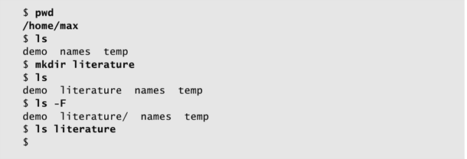
mkdir: Create a Directory

Slide 14
Paths
Absolute paths
/ (root) - root directory
~ (tilder) – home directory
Relative paths
.. - parent directory
. – current directory

Slide 15
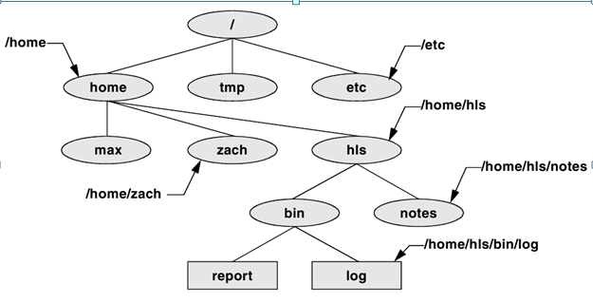
Absolute Paths

Slide 16
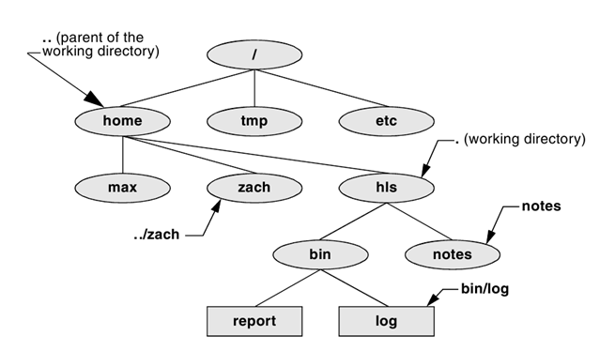
Relative Paths
Notes:
Abbreviation:
Home directory ~ - ~/project1
Working directory . – a file named file1 can be referred to in 4 different ways:
file1
./file1
~file1
~victoryu/file1
Parent directory ..

Slide 17
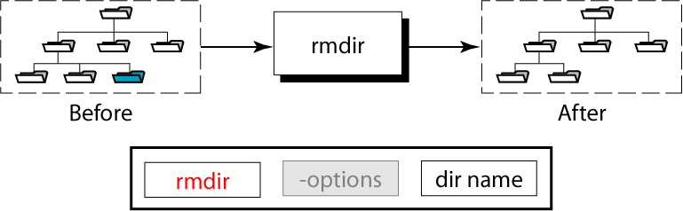
rmdir: Remove a Directory

Slide 18
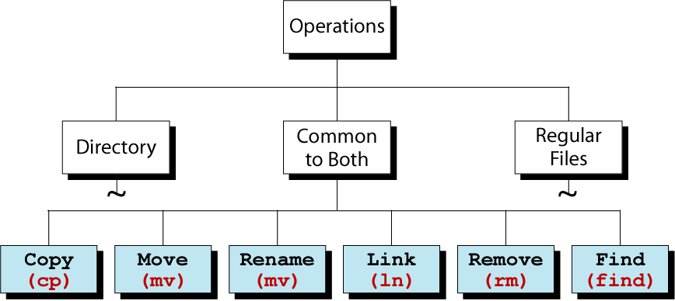
Regular File Utilities

Slide 19
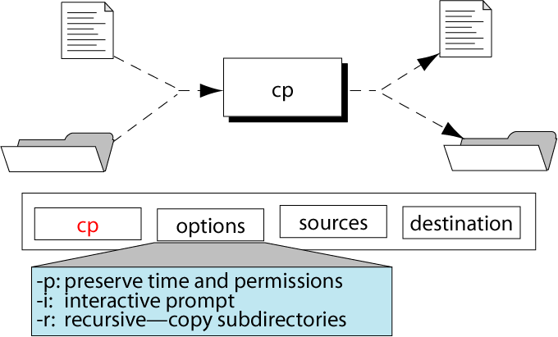
The cp Command

Slide 20
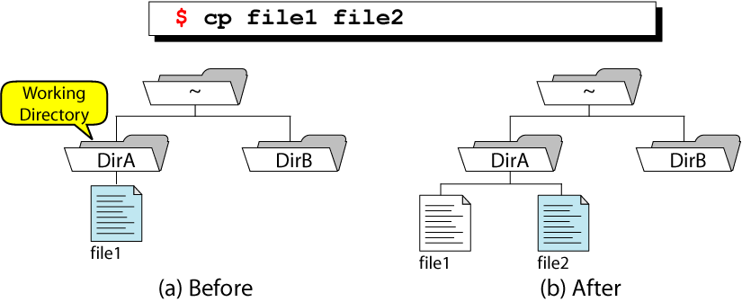
Simple File Copy

Slide 21
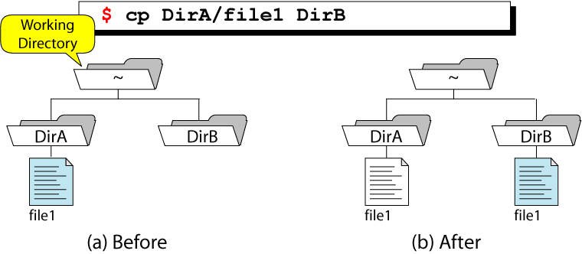
Copy File to a Directory from Home

Slide 22
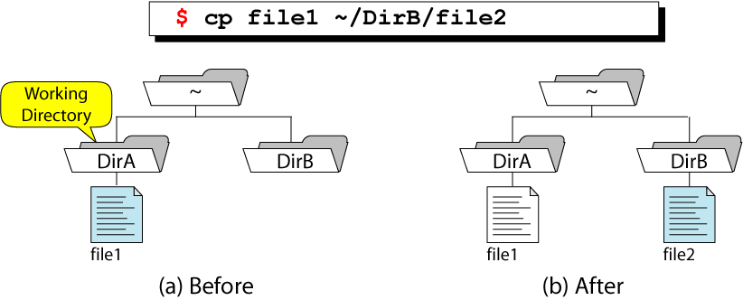
Copy and Rename a File

Slide 23
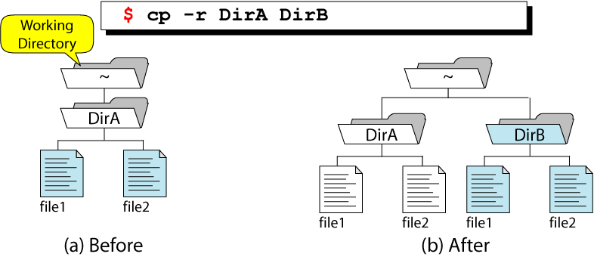
Recursive Copy

Slide 24
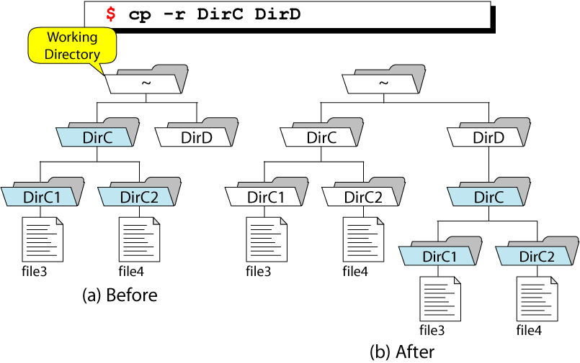
Recursive Copy with Subdirectories

Slide 25
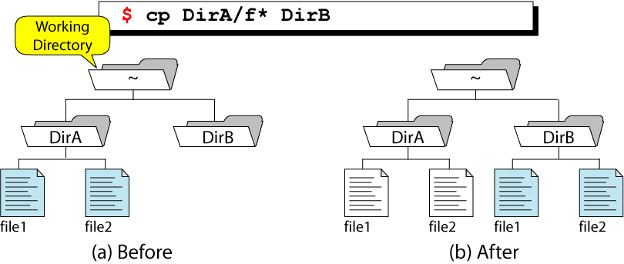
Wildcard Copy

Slide 26
File Ownership and Permissions
Three levels of file ownership
User
Group
Other
Within each level, 3 types of permissions
Read
Write
Execute
Notes:
3 levels of file ownership
User: refers to the single userid that’s primarily in charge of the file. You have this level of ownership for the files you create.
Group: refers to the group (of users) associated with a specific file. All users within the group have the same permissions for interacting with a file. For example, unixStudent
Other: Refers to any users not identified with either the group or user for a file.
3 types of permissions
Read: users with read permission can only view a file; they can not make changes to it.
Write: users with write permission can make changes to or delete a file.
Execute: users with execute permission can run files (programs or scripts) and view directories.

Slide 27
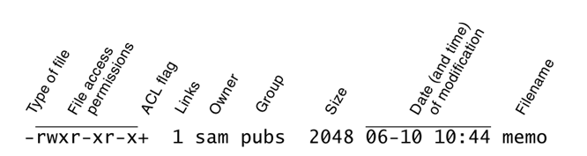
ls –l: Displays Permissions, etc.

Slide 28
chown: Change Ownership
After the change, the new owner will be able to do anything with the file
Use –R option to apply recursively
If the system does not allow you to use chown, consider using cp to accomplish the same thing.

Slide 29
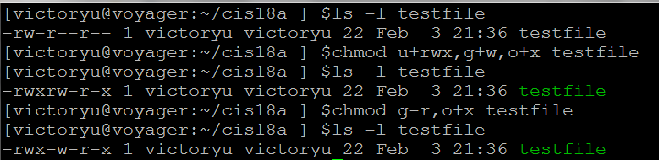
Symbolic Arguments to chmod
Choose One From Each
User Operator Permission
u user
g group
o other
a all users
+ Add
- Remove
= Equal
r read
w write
x execute
s GUID/SGID
t sticky
Notes:
Two advanced permissions are available:
Set User ID (SUID) and Set Group ID (SGID): when you execute a file that has set user id permission, the process executing the file takes on the privileges of the file’s owner. For example, if you run a SUID program that removes all files in a directory, you can remove files in any of the file owner’s directories, even if you do not normally have permission to do so. In a similar manner, set group id (SGID) permission gives the process executing the file the privileges of the group the file is associated with.
Sticky bit: is represented by a t at the end of the list of permissions. Setting the “sticky bit” means primarily that, in a shared directory, you can delete only your own files (and not accidentally delete files belonging to others. Files can be deleted by:
User with root privileges
User who has written permission AND owns the directory chmod +t cis18a/dropbox (or: chmod 1755 cis18a/dropbox)
When you use four digits to specify permissions, setting the first digit to 1 sets the sticky bit, setting it to 2 specifies SGID permission, and setting it to 4 specifies SUID permissions: $ls –l myprog* -rwxr-xr-x. 1 root pubs 362804 03-21 15:38 myprog1 -rwxr-xr-x. 1 root pubs 189960 03-21 15:38 myprog1 $chmod 4755 myprog1 $chmod 2755 myprog2 $ls –l myprog* -rwsr-xr-x. 1 root pubs 362804 03-21 15:38 myprog1 -rwxr-sr-x. 1 root pubs 189960 03-21 15:38 myprog1

Slide 30
Absolute Arguments to chmod
$ls –l | cut –d” “
$chmod 270 test2$ls -l testfile1 | cut -d" " -f1
-rwxrw-r-x
$chmod 765 testfile
-rwxrw-r-x
Numeric Equivalent for Mnemonic Permissions
Mnemonic (rwx) | Binary | Octal
--- | 000 | 0
--x | 001 | 1
-w- | 010 | 2
-wx | 011 | 3
r-- | 100 | 4
r-x | 101 | 5
rw- | 110 | 6
rwx | 111 | 7
Notes:
Every one of the three digits on the mode number corresponds to one of the three permission triplets. (u, g and o) Every permission bit in a triplet corresponds to a value: 4 for r, 2 for w, 1 for x. If the permission bit you add this value to the number of the permission triplet. If it is cleared, then you add nothing. (Some of you might notice that in fact, the number for a triplet is the octal value corresponding to the three-bit pattern - if you don't know what an octal value is, it doesn't really matter, just follow the instructions) So if a file has rwxr-xr-x permissions we do the following calculation:
Triplet for u: rwx => 4 + 2 + 1 = 7 Triplet for g: r-x => 4 + 0 + 1 = 5
When you use four digits to specify permissions
Setting the first digit to 1 sets the sticky bit
Setting the first digit to 2 sets the GUID permissions
Setting the first digit to 4 sets the SGID permissions
Tripler for o: r-x => 4 + 0 + 1 = 5 Which makes : 755

Slide 31
User Mask
Mask | Directory Permission (Default 777) | File Permission (Default 666)
0 | 7 (rwx) |  | 6 (rw-)
1 | 6 (rw-) |  | 6 (rw-)
2 | 5 (r-x) |  | 4 (r- -)
3 | 4 (r- -) |  | 4 (r- -)
4 | 3 (-wx) |  | 2 (-w-)
5 | 2 (-w-) |  | 2 (-w-)
6 | 1 (- -x) |  | 0 (- - -)
7 | 0 (- - -) |  | 0 (- - -)
Notes:
When a new directory or file is created, the number in the mask is used to set the default permissions. The default permissions are 777 for a directory and 666 for a file.
Each mask digit means remove the corresponding digits from the default permission. For example, mask digit 1 means remove 1 from directory and file permission.
umask: Change default permission
Everytime you create a file, the Unix system applies default permissions for you. You can change the default permissions using the umask command, but the numeric value you specify here is not the same as the one you’d use with chmod.
To figure the umask value for a file:
Start with 666 (removes execute permission)
Figure out which numeric values you’d use to set you desired permissions with the chmod command
Subtract that numeric value from 666. The result is the umask value
Issue umask command
e.g., if you want to set chmod 644:
666-644=022.
umask 022
For a directory, start with 777
You cannot set the default permissions to include execute permission. It’s a security feature, not an omission.
Use umask or umaks –s (depending on the shell and environment settings) to display your current umask settings.

Slide 32
umask Utility
$umask
000
$umask 022
Examples of Default Permission Calculation
Mask | Directory Permissions (Default 777) | File Permissions (Default 666)
000 (Public) | 777 (rwxrwxrwx) | 666 (rw-rw-rw)
011 (Public) | 766 (rwxrw-rw-) | 666 (rw-rw-rw)
022 (Write Protected) | 755 (rwxr-xr-x) | 644 (rw-r—r--)
007 (Project Private) | 770 (rwxrwx---) | 660 (rw-rw---)
077 (Private) | 700 (rwx------) | 600 (rw------)
Notes:
For directories, the default permission is 7 (4 + 2 + 1), so we remove the 1 and the result is 6 (4 + 2). The default for a file, on the other hand, is 6 (4 + 2) so there is no 1 to be removed. The result is, therefore, also 6 (4 + 2).

Slide 33
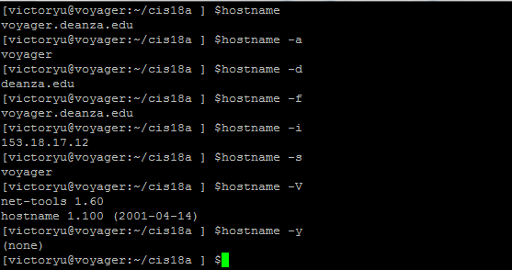
hostname: Displays the System Name
Notes:
hostname [option] [nameofhost]
Set or print name of current host system. A privileged user can set the hostname with the nameofhost argument.
-a, --alias
Display the alias name of the host (if used)
-d, --domain
Print DNS domain name
-f, -fqdn, --long
Print fully qualified domain name
-F file, --file file
Consult file for hostname
-h, --help
Print a help message and then exit
-i, --ip-address
Display the IP address(es) of the host
-s, --short
Trim domain information from the printed name
-V, --version
Print version information and then exit

Slide 34
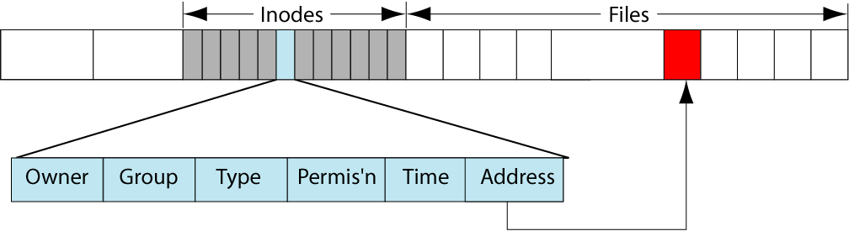
Inode
Notes:
A data structure that contains information about a file.
Owner ID
Group ID
File type
File permissions
Time the file was last accessed and modified
Address
Data
In a hard link structure, the inode in the directory links the file name directly to the physical file. It cannot be used to link to directories
A symbolic link is a logical file that defines the location of another file somewhere else in the system. It can be used for both files and directories
Display inode information:
ls –i
stat
file

Slide 35
Links
A pointer to a file
Hard link – the specific location of physical data
Symbolic (or soft) links – pointers to a
Two pieces of information
A name
An inode number
Notes:
A link is a logical relationship between an inode and a file that relates the name of a file to its physical location. UNIX defines two types of links: hard links and symbolic links.

Slide 36
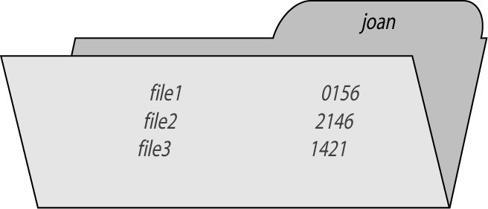
A Directory of Three Files

Slide 37
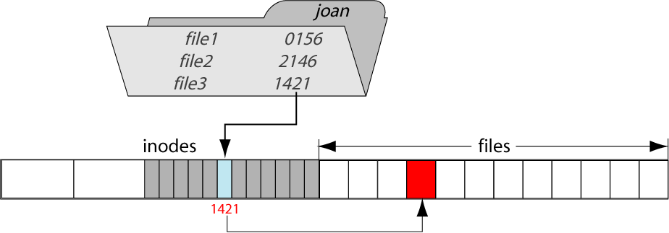
A Hard Link
Notes:
A hard link enables you to give a file another name. This is done by creating an entry in a directory; no additional disk space is consumed.
Hard Link is created by default, with the command ln. The syntax of the command is much like cp and mv, as in the following example:
$ ln old_name new_name
The new_name can be either an absolute or relative pathname.
In a hard link structure, the inode in the directory links the filename directly to the physical file. Inodes are associated with precisely one directory entry at a time. However, with hard links it is possible to associate multiple directory entries with a single inode. To create a hard link use ln command as follows:
$ ln /root/file1 /root/file2 $ ls –l
Above commands create a link to file1.

Slide 38
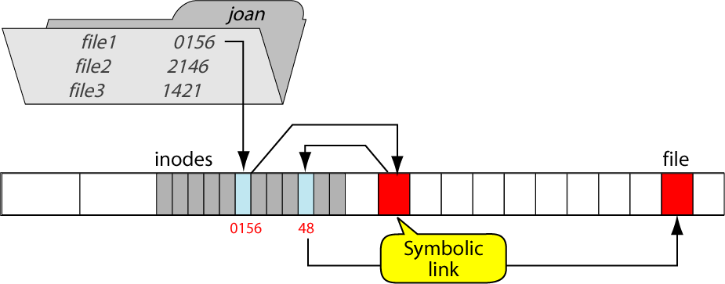
A Symbolic Link
Notes:
The second kind of link is the symbolic or soft link. These kinds of links are used to attach a file or directory to another one.
A symbolic (or soft) link is a structure in which the inode is related to the physical file through a special file known as a symbolic link.
When you create a hard link, the permissions on the link are the same as those on the original file. When you create a symbolic link, the permissions become much different. Those permissions you see are meaningless—they apply only to the link and not the file itself. You cannot change these permissions, and would accomplish nothing by doing so, for the permissions that were in effect on the original file still are, and they are checked by the link before any operations are performed.

Slide 39
Hard Links vs. Soft Links
A hard link is an alias to to a file
Hard link – the specific location of physical data
Can’t make a hard link to a directory
Can ‘t span file systems
A symbolic link is a pointer to a pathname, not a pointer to the file itself
ln –s original target creates a symbolic link
Is not equivalent to a hard link, and has a different inode
Can make a soft link to a directory
Notes:
Find all the files with the same inode number find –samefile /path/to/your/file or, if you already know the inode number: find –inum 36220628
There is no way to tell how many symbolic links there are to a file
The biggest difference between hard and symbolic links occur when a link a removed.

Slide 40
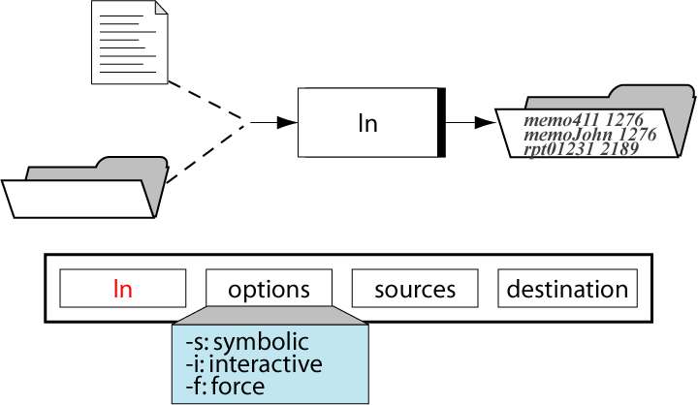
The ln Command

Slide 41
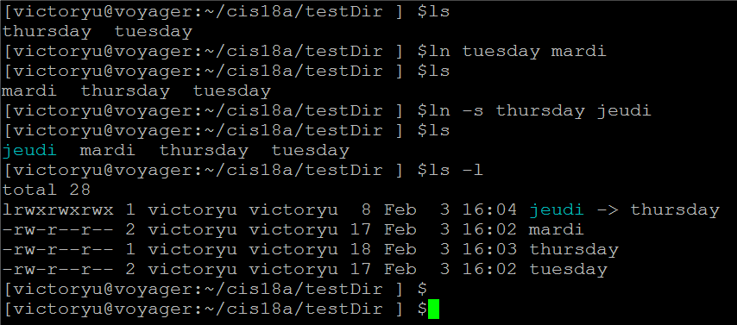
ln: Create Link
Notes:
Notice the link count, which is the number immediately following the permissions.

Slide 42
find : Search for a File
Syntax: find [path] [option] filename
-name File name find . -name "Jose*“ find /home –name test.txt
-perm File permission find . –perm 644
-atime n File status last accessed n*24 hours ago
-empty File is empty
find [path] [action] command
-exec find . -name file3 -exec cp {} {}.bak \; -exec rm {} \;
Notes:
find . -name "Jose*“ -print (find all the file whose name starts with Jose) (On some Unix systems, -print is not needed. Test without –print first)
find . –perm 644 –print (find all the file whose permission bits are 644)
find . -name file3 -exec cp {} {}.bak \; -exec rm {} \; find the file named “file3” in the current directory, make a copy of it, and remove it.
Find all the files with the same inode number find –samefile /path/to/your/file or, if you already know the inode number: find –inum 36220628

Slide 43
Command Comparison
Command | Apply to Files? | Apply to Directories?
cat | Yes | No
cd | No | Yes
rm | Yes | Yes
cp | Yes | Yes
mv | Yes | Yes
ls | Yes | Yes
find | Yes | Yes
mkdir | No | Yes
rmdir | No | Yes (empty directory only)
touch | Yes | Yes

Slide 44
ACLs: Access Control Lists
ACLs provide a set of finer-grained rules specifying how a specific user or group can access a file or directory
Syntax: setfacl –modify ugo:name:permission file
Example: set default rules setfacl –d –m g:pubs:r-x,g:adm:rwx dir
Example: modify rule(s) in a file's ACL setfacl –modify g:unixStudent:rw dropbox
Example: display info about an ACL associated file getfacl dropbox
Notes:
$echo "This is a test file" > cis18a/dropbox/testFile
$ls -ld cis18a/dropbox/testFile
-rw-r--r-- 1 victoryu victoryu 20 Feb 19 22:21 cis18a/dropbox/testFile
$setfacl --modify g:unixStudent:7 cis18a/dropbox/testFile
$ls -ld cis18a/dropbox/testFile
-rw-rwxr--+ 1 victoryu victoryu 20 Feb 19 22:21 cis18a/dropbox/testFile
$getfacl cis18a/dropbox/testFile
# file: cis18a/dropbox/testFile
# owner: victoryu
# group: victoryu
user::rw-
group::r--
group:unixStudent:rwx
mask::rwx
other::r--

Slide 45
Review Questions
What is an inode? What happens to the inode when you move a file within a filesystem?
How can you create a file named -i? Which techniques do not work, and why don’t they work? How can you remove the file name –i?
How to find all files with permission 644 and SGID bit set?
Notes:
cAn inode is a data structure stored on disk that defines a file’s existence and is identified by an inode number. When you move (mv) a file within a filesystem, you change the filename portion of the directory entry associated with the inode that describes the file.
Most utilities assume –i is an option, not the name of a file, and therefore do not work properly when they are called with an argument of a file named –i:
$ touch -i
touch: invalid option -- i
Try 'touch --help' for more information.
The following commands create a file named –i:
$ cat > -i
CONTROL-D
The preceding example uses the shell to create the file. It works because the shell expects a filename following a redirect output symbol and does not treat –i as an option.
Many utilities assume everything on the command line to the right of a -- option is a filename. Using one of these utilities, you can work with a file whose name begins with a hyphen by marking the end of the options on the command line with the –– option followed by the filename:
$ touch -- -i
You can remove the file by using –– to signal the end of the options:
$ rm -- -i
One of the easiest ways to create and remove this file is to locate it in the working directory as ./–i. The filename does not begin with a hyphen so there is no confusion.
$ touch ./-i
$ rm ./-i
3. To find all files with permission 644 and SGID bit set, enter command: find . –perm 6442

